Slide 1
CoursePlanner
Palak Choudhary (choudhary.palak@gatech.edu) - Lead member
Chris Collins (ccollins63@gatech.edu)
Presented on: December 3, 2018, 13:00

Slide 2
Project motivation
Planning a student’s schedule has many hurdles
Many resources to synthesize from
GPA
Graduation requirements
Need a tool to facilitate schedule planning

Slide 3
CoursePlanner
Draws from Course Critique, Buzzport
Allows student to input:
Proposed schedule (up to 7 classes)
Desired GPA
Whether they are graduating or not
Tries to improve schedule to help students:
Graduate on time
Achieve the cumulative GPA they want

Slide 4
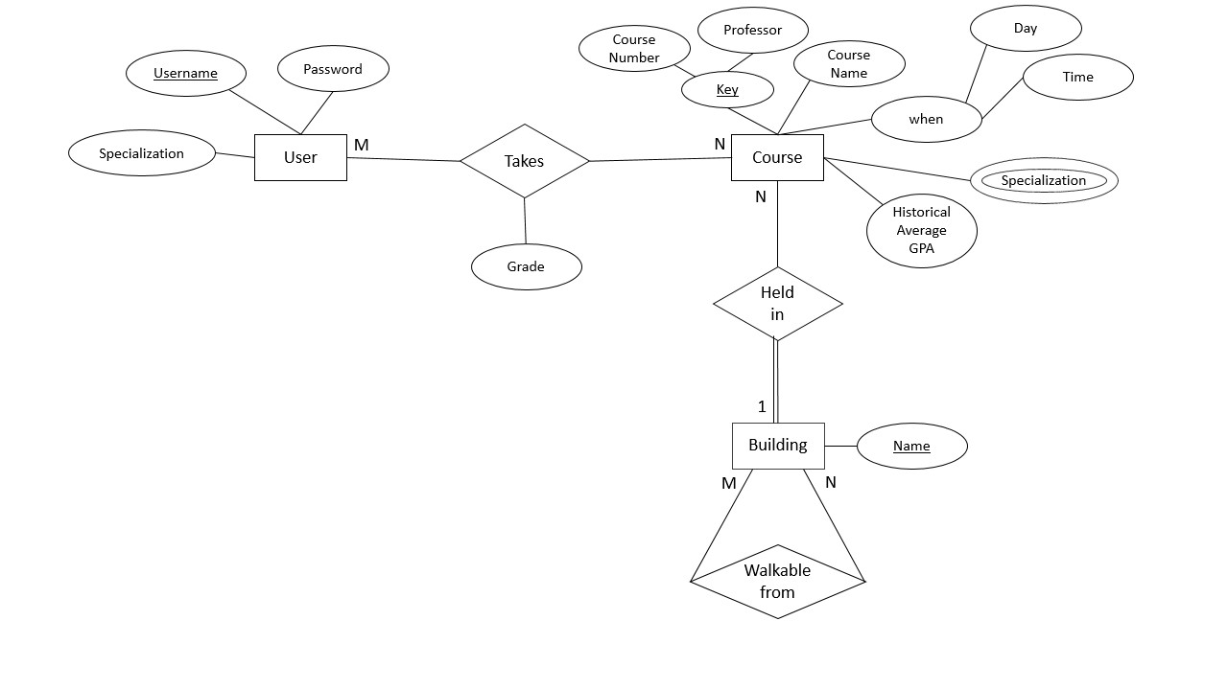
ER Schema

Slide 5
Tables
COURSES
USERS
TAKEN
SPECIALIZATIONS
crn | cname | prof | start_time | end_time | gpa | location | day_code
Username | Password | Specialization
Username | crn | prof | grade
crn | prof | specialization

Slide 6
Actual Implementation
Successfully implemented:
Relevant course recommendation
GPA improvement
Failed to implement:
Walkability measure
Graduation Requirement Check

Slide 7
Problems Faced
Node JS Implementation
Asynchronous nature makes query results unpredictable
Had to establish Promises to ensure query results were consistent
Learning curve due to unfamiliarity
Joins required were very complex
Ensuring no time clashes turned out to be harder than imagined

Slide 8
Lessons Learned
Database design → code is not trivial
SQL has some very real limitations
Needed multivalued attributes
Also have to consider code aspects beyond SQL
Front-end, javascript
Gained a lot of practical DB design experience
Asynchronous programming with Node JS

Slide 9
Future Possibilities
Utilize more historical data
Check graduation requirements
More heuristics for new classes
Some front-end issues need to be resolved
Drop downs in a few fields
Ability to update profile

